Slide 1

Estimating Salaries Of NBA Players Using Predictive Modeling Techniques 16th August, 2019
Eric Naumann
Brandon Whiteley
Yeong-in Jang
Aishwarya Pawar
Haritha Maheshkumar
The University of Texas at Austin, McCombs School of Business - MSBA Class of 2020

Slide 2
Agenda
Problem statement (What are we doing?)
Exploratory Data Analysis (Why are we doing it?)
Methodology & Results summary (How are we doing it?)
Findings and Insights (What did we find?)
Next steps and ideas (What can be done better and how?)

Slide 3
What metrics can be used to predict NBA player salaries?
Problem statement
Exploratory Data Analysis
Methodology & results summary
Findings & Insights
Next steps
Key questions: Out of the many assessment metrics, which have been significant in estimating a player’s salary? How accurate is the estimation? How are they different from rest of the metrics?
Available information: Dataset containing salary and performance information of 419 NBA players, spanned over 48 variables
Sample variable types / Data snapshot:
Per Game Metrics: Minutes, Field Goals, 3 pointers, Free Throws, Rebounds etc..
Percentage Metrics: FT%, 3PT% etc..
Advanced Metrics: PER, True Shooting %, TO%, Usage %, Win Shares, Plus Minus, etc..

Slide 4
Cleaning the data and observing the relationships across variables
Problem statement
Exploratory Data Analysis
Methodology & results summary
Findings & Insights
Next steps
Eric
Data cleaning:
Predictors from 2017 are used to predict salary information in 2018
0.09% of players were removed due to missing information in a few metrics
Averaged stats for players who played for multiple teams
Correlations:
Correlated variables were removed in some regressions (Corr<Abs(0.5))
Ex: 2 PT FGs , FGA per game, & 2 PT FGA
Effective Field Goal Percentage ~ True Shooting Percentage ~ Field Goal Percentage
Notes:
We did not average games and games started for players
Correlations observed:
2 PT FGs , FGA per game, & 2 PT FGA are highly correlated with each other (similarly the %s)
2 PT FG per game is highly correlated with usage %, TO per game, points per game, & FT per game
All %s and per game stats seems to be highly correlated
Effective Field Goal Percentage ~ True Shooting Percentage ~ Field Goal Percentage
Free Throws Per Game ~ Points per Game
Defensive Rebounds Per Game ~ Defensive Win Shares
Offensive Win Shares ~ Value over Replacement Player ~Win Shares
Box plus ~ offensive box plus
Player efficiency rating ~ win share

Slide 5
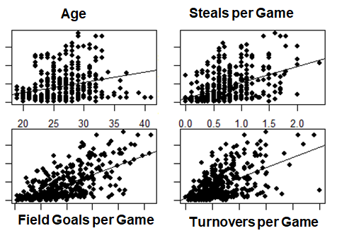
Age, Steals, Field Goals, Turnovers (per game) metrics show a promising relationship with the salaries
Problem statement
Exploratory Data Analysis
Methodology & results summary
Findings & Insights
Next steps
Other potential significant variables :
Minutes played per Game
Win Shares
2 Points Field Per Points
Value over replacement player

Slide 6
We tried estimating the salaries of players using the following predictive modeling techniques
Problem statement
Exploratory Data Analysis
Methodology & results summary
Findings & Insights
Next steps
Modeling technique | Refinements tried | Test RMSE obtained | Variance Explained
Linear | Introduced interaction terms Tested for non-linear relationships | USD 5.14M | 58.11%
Ridge | Best lambda selection based on RMSE curve | USD 5.48M | 59.23%
Lasso | Best lambda selection based on RMSE curve | USD 5.45M | 59.81%
Random Forest | Experimentation with mtry (best result at mtry=23) Variable elimination using importance() function | USD 5.46M | 58.99%
Bagging | 31 variables selected based on importance() function | USD 5.24M | 54.31%

Slide 7
Linear Regression with Variable Selections
Problem statement
Exploratory Data Analysis
Methodology & results summary
Findings & Insights
Next steps
AIsh
All Variables OLS
# Significant Variables= 14
RMSE = 5.34 M
Forward Selection OLS
# Significant Variables= 5
RMSE = 5.16 M
Backward Selection OLS
# Significant Variables= 7
RMSE = 5.14 M
Salary = - 7,862,915 + 429,094×Age - 48,917×Games + 66,699×Games started + 547,183×Field goal attempts per game + 1,041,936×Free throw attempts per game - 1,429,831×Turnovers per game + 1,580,038×Value over replacement player

Slide 8
Linear Regression with Non-linearity and Interactions
Problem statement
Exploratory Data Analysis
Methodology & results summary
Findings & Insights
Next steps
AIsh
Non- Linearity
Interactions
Non- Linearity was observed for win share (2 degree) and box plus (2 and 3 degree
RMSE post introducing non-linearity = 5.17 Mn
Interaction between was observed
RMSE post introducing interaction = 5.17 Mn

Slide 9
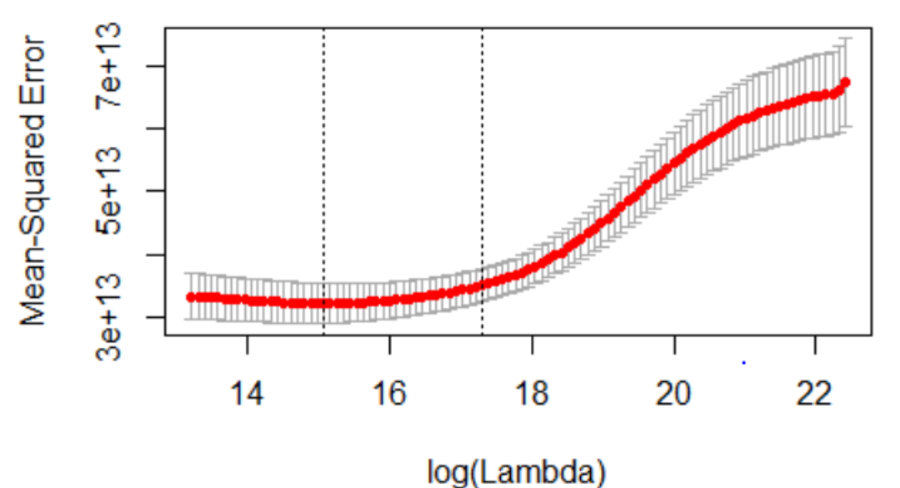
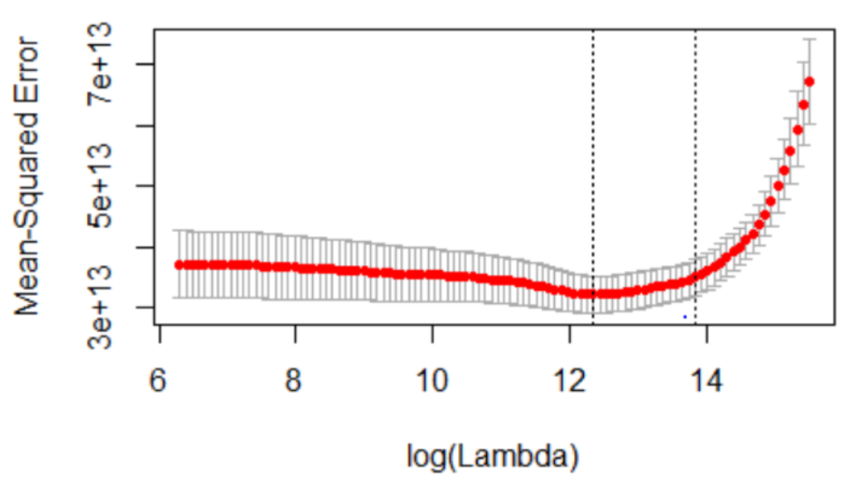
Ridge and Lasso
Problem statement
Exploratory Data Analysis
Methodology & results summary
Findings & Insights
Next steps
AIsh
With minimum Lambda, we obtained RMSE of 5.48 Mn
With minimum Lambda, we obtained RMSE of 5.45 Mn

Slide 10
We tried estimating the salaries of players using the following predictive modeling techniques
Problem statement
Exploratory Data Analysis
Methodology & results summary
Findings & Insights
Next steps
Modeling technique | Refinements tried | Test RMSE obtained | Variance Explained
Linear | Introduced interaction terms Tested for non-linear relationships | USD 5.14M | 58.11%
Ridge | Best lambda selection based on RMSE curve | USD 5.48M | 59.23%
Lasso | Best lambda selection based on RMSE curve | USD 5.45M | 59.81%
Random Forest | Experimentation with mtry (best result at mtry=23) Variable elimination using importance() function | USD 5.46M | 58.99%
Bagging | 31 variables selected based on importance() function | USD 5.24M | 54.31%

Slide 11
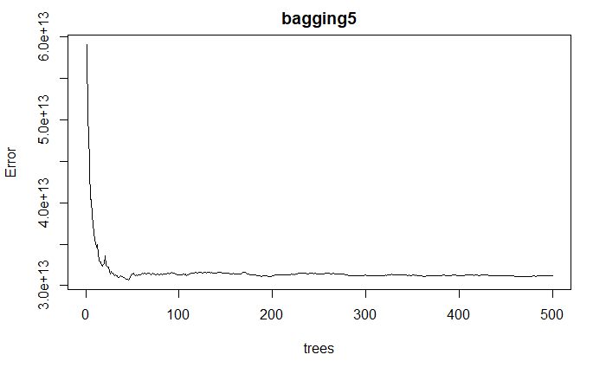
Bagging :
Problem statement
Exploratory Data Analysis
Methodology & results summary
Findings & Insights
Next steps
Brandon
The accuracy just doesn’t improve

Slide 12
...ctd
Problem statement
Exploratory Data Analysis
Methodology & results summary
Findings & Insights
Next steps
Modeling technique | Refinements tried | RMSE obtained | Variance Explained
PCR | Chose # principal components model based on min RMSE | USD 5.07M | -
Boosting | 31 variables selected based on importance() function | USD 5.24M | 54.31%
Neural networks | 1. Choose the size and decay factor with minimum RMSE | USD 617K

Slide 13
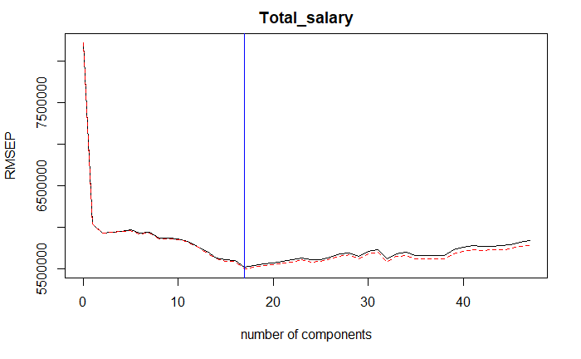
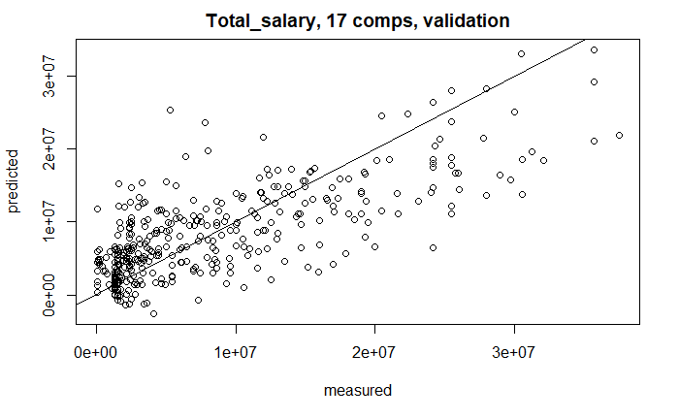
Principal Component Regression
Problem statement
Exploratory Data Analysis
Methodology & results summary
Findings & Insights
Next steps
Yeong
Number of Components : 17
Test RMSE : 5.07 Mil
Adjusted R_squared: 57.34%

Slide 14
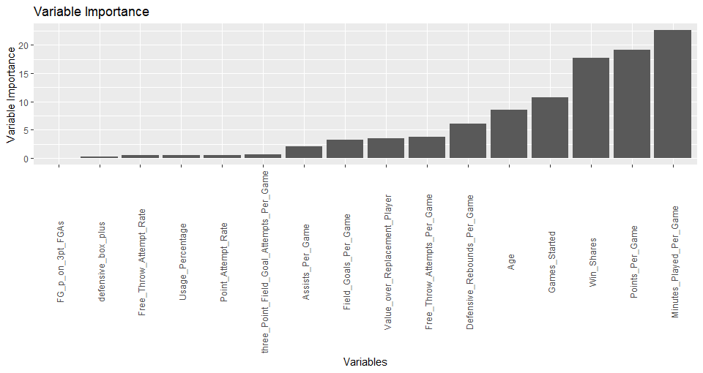
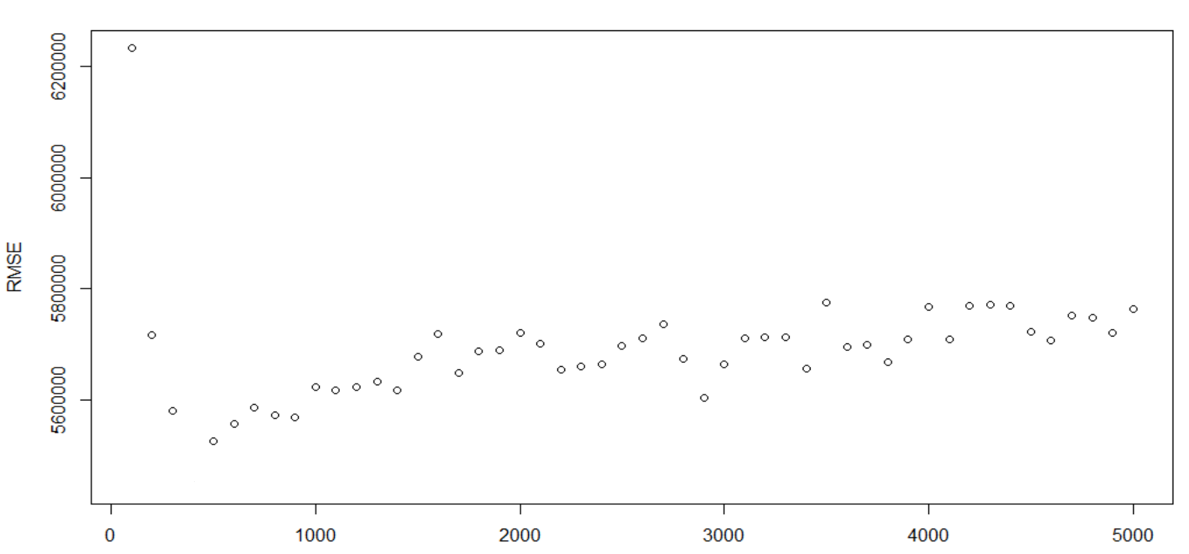
Boosting :
Problem statement
Exploratory Data Analysis
Methodology & results summary
Findings & Insights
Next steps
Yeong
Best Iteration with shrinkage factor=0.01 and #Trees = 500, : RMSE: 5.4Mil
Number of Trees
The accuracy just doesn’t improve

Slide 15
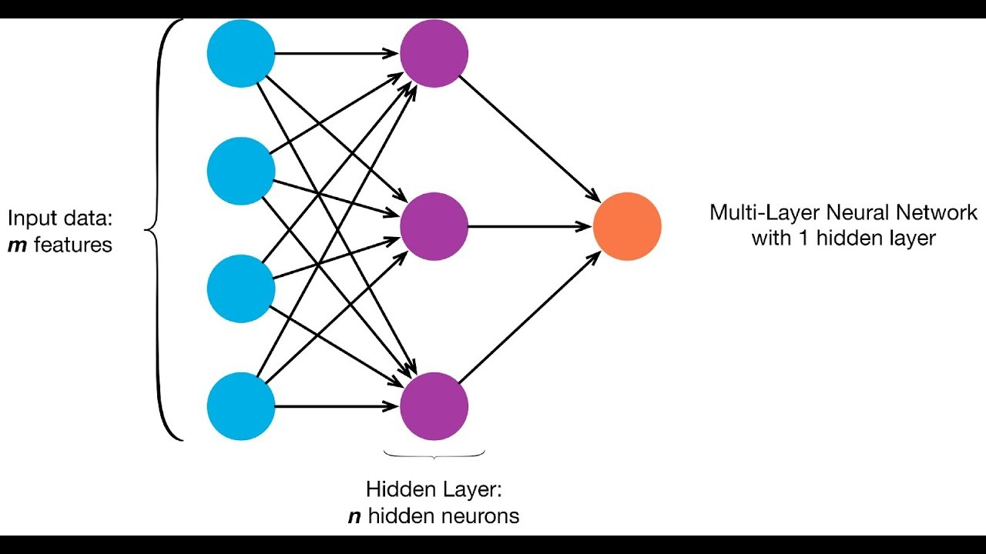
Neural Network :
Problem statement
Exploratory Data Analysis
Methodology & results summary
Findings & Insights
Next steps
Yeong
Best Iteration with decay factor=0.01
and size= 10
RMSE obtained : $ 617K

Slide 16
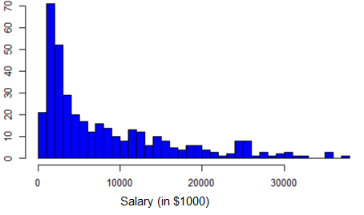
We observed that irrespective of any variations, there was still an average error of USD 5M associated with our model, and we explored why…
Problem statement
Exploratory Data Analysis
Methodology & results summary
Findings & Insights
Next steps
The skewness of the dependent variable could be the reason behind the high RMSE
Our hypothesis was that variation in salary could be better explained if similar salaried players are grouped together
Since salary is what we’re trying to predict, we tried using other independent variables to group the players, as a proxy

Slide 17
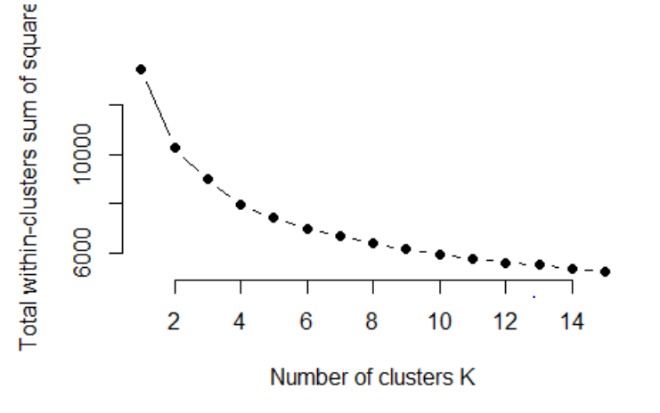
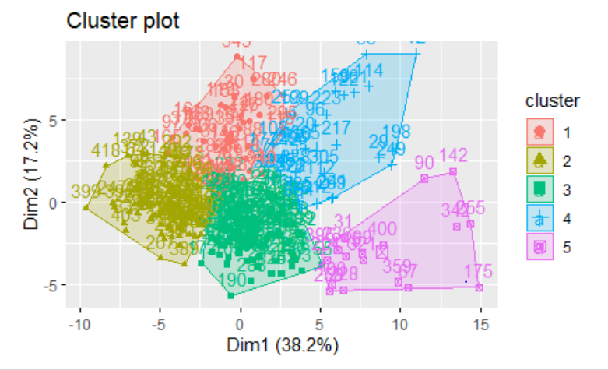
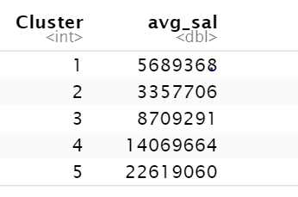
Grouping the players into different clusters, reduced the variation in salaries and combined similar players together
Problem statement
Exploratory Data Analysis
Methodology & results summary
Findings & Insights
Next steps
1
2
3
Optimal number of clusters were selected based on the elbow curve. Well, 5 seemed like a good point (Maybe not?)
The average salaries across the 5 clusters indicates that the objective of grouping the players based on their salaries is achieved to an extent
However, increase in number of clusters, decreased the data points in each clusters to ~60 per cluster
Linear regression
28% and 4,649,000 - k=5
35% and 4,566,000 - k=4
48% and 6,016,000 - k=3
47.8% and 6,616,000 - k=2

Slide 18
Improving Predictions in the future
Problem statement
Exploratory Data Analysis
Methodology & results summary
Findings & Insights
Next steps
Brandon
Examining only contracts signed in the previous season
Contracts signed during different years use a different salary cap number
Examining the contracts in subsets
Some players such as LeBron James are undervalued because the cap doesn’t allow for him to be paid market value

Slide 19
Problem statement
Exploratory Data Analysis
Methodology & results summary
Findings & Insights
Next steps
Questions?

Slide 20
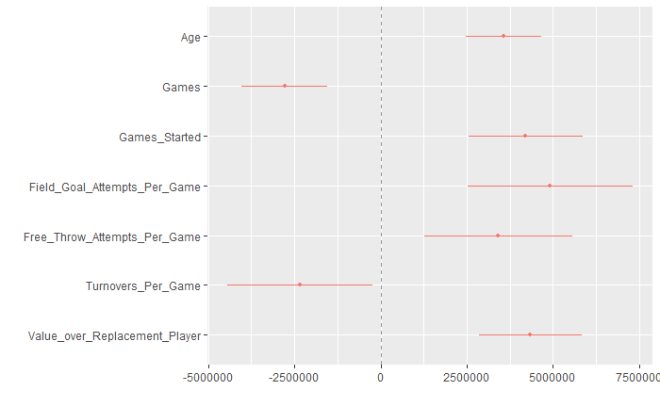
Linear Regression
Problem statement
Exploratory Data Analysis
Methodology & results summary
Findings & Insights
Next steps
Test RMSE : 5,140,189
Best subset method : Backward
Salary = - 7,862,915 + 429,094×Age - 48,917×Games + 66,699×Games started
+ 547,183×Field goal attempts per game + 1,041,936×Free throw attempts per game
- 1,429,831×Turnovers per game + 1,580,038×Value over replacement player

